Slide 1


Team 22: Solar Home Lighting
Bi-Weekly Update 5 Jack Holdridge
Kyle Walcher
Matthew Greer
Adam Garcia Sponsor: Won Jang TA: Guanhua Tao
Notes:
Michelle

Slide 2
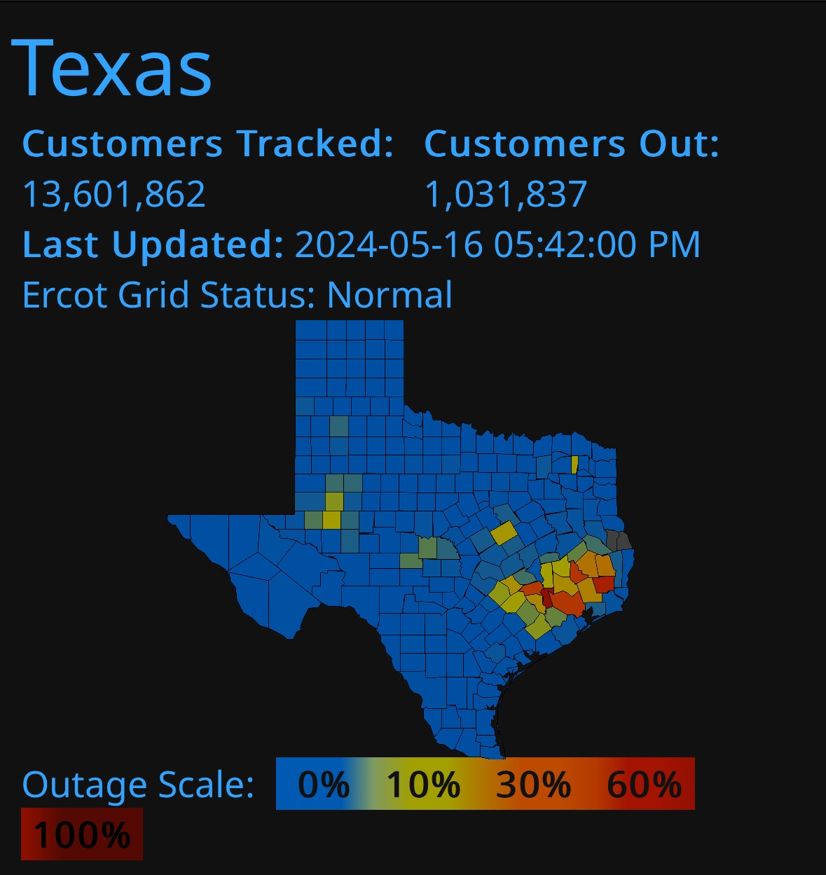
Project Summary
Problem statement:
Current smart-home systems depend on grid power and cloud connectivity, causing lighting and monitoring to fail during outages and creating reliability and usability barriers for users.
Our Solution:
Combine security, lighting control, and user interaction into one coordinated platform
Offer flexible controls, with both local and remote capabilities.
Ensures the home remains safely lit and monitored regardless of grid fluctuations.
Notes:
Kyle

Slide 3
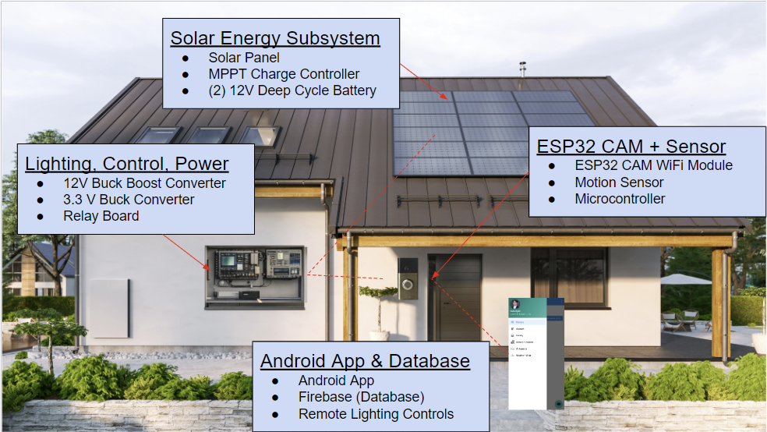
Integrated System Diagram
Notes:
Eric

Slide 4
Project Timeline
Subsystem Designs updated and ready for integration (to complete 2/4/26) | Integration of Database with application (completed 1/28/26) | Integration of motion controls with android application (complete 2/18/26) | Final Integration (to complete 3/4/26) | System Test (to complete 3/18/26) | Validation of system (to complete 3/25/26) | Demo (to complete 4/15/26)
Notes:
Eric

Slide 5
MPPT Charge Controller Adam Garcia
Accomplishments Update 12 Hours | Ongoing progress/problems and plans until the next presentation
MPPT IC charges batteries ESP32 switches batteries One battery charges while the other discharges to the load No back current flow from one battery to another when switching | 3.3V Buck Converter to power ESP32 failed Bluetooth communication with Main MCU

Slide 6
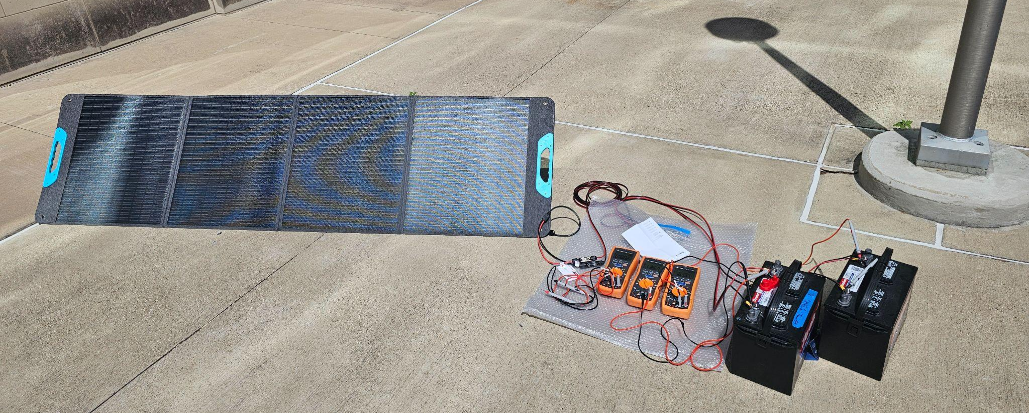
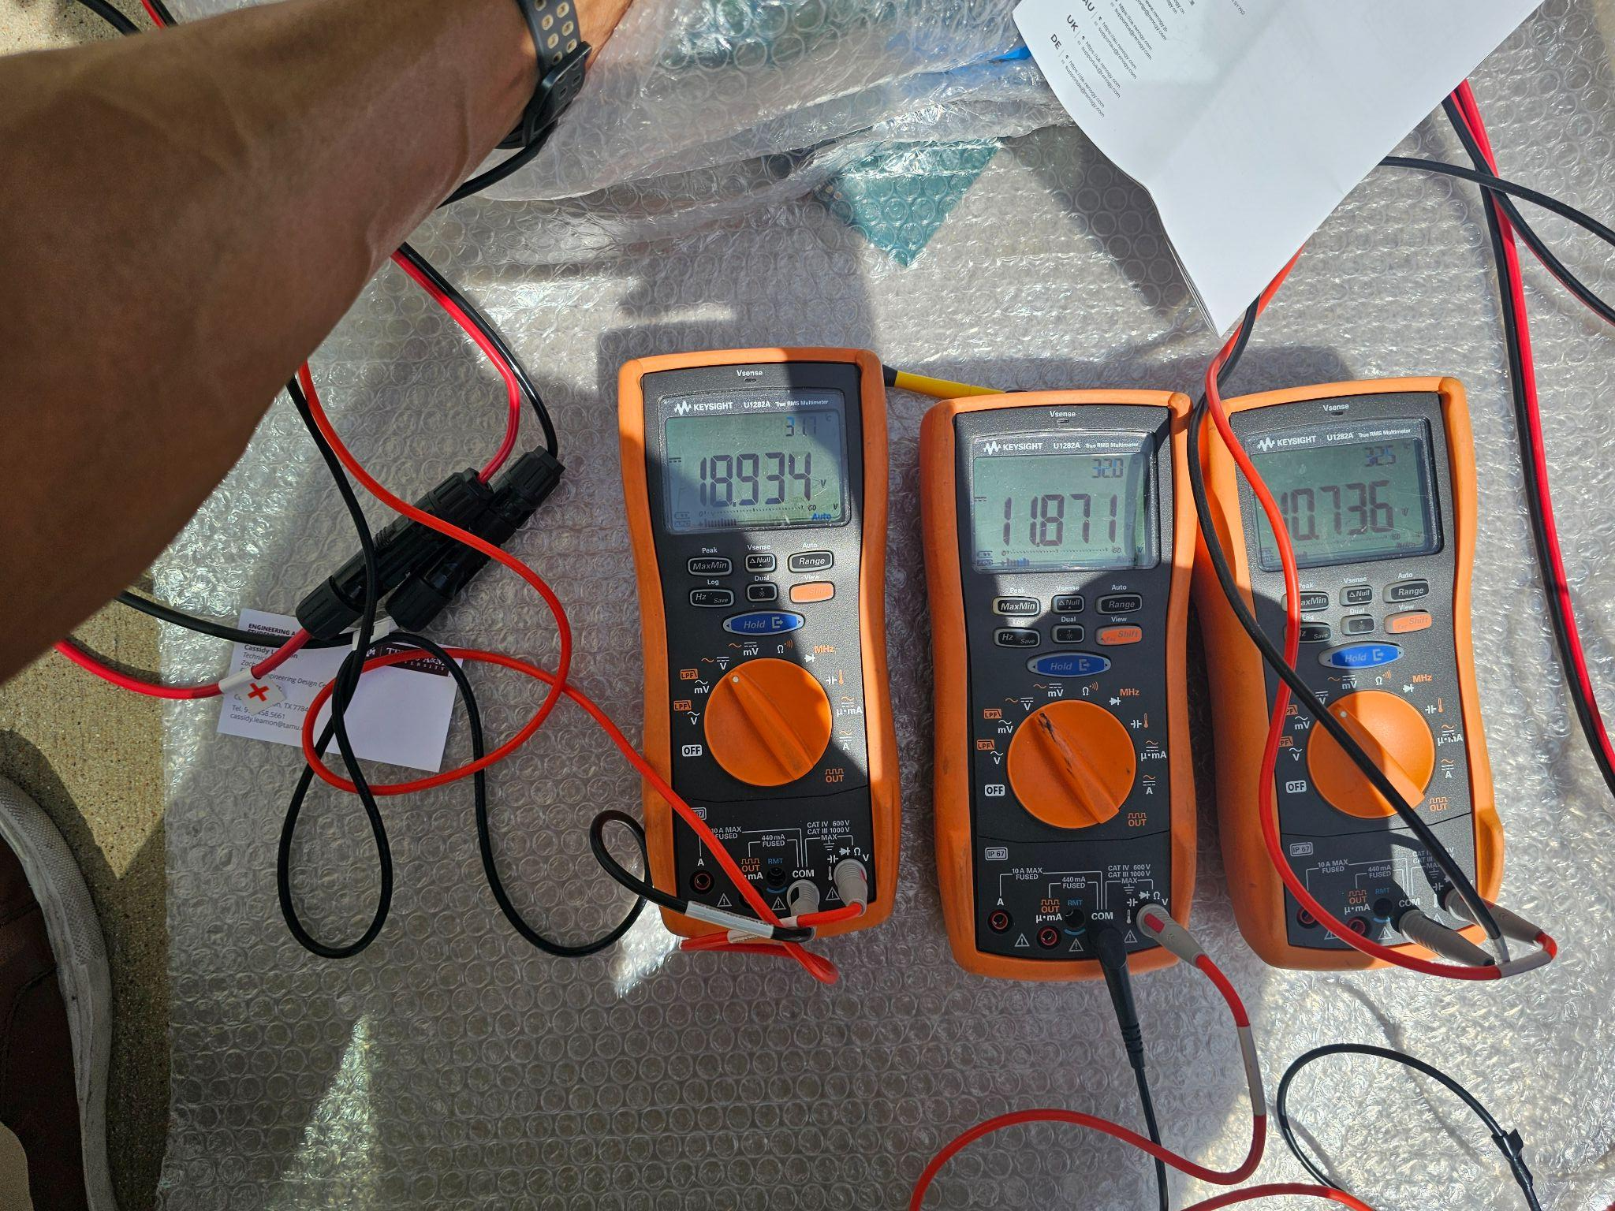
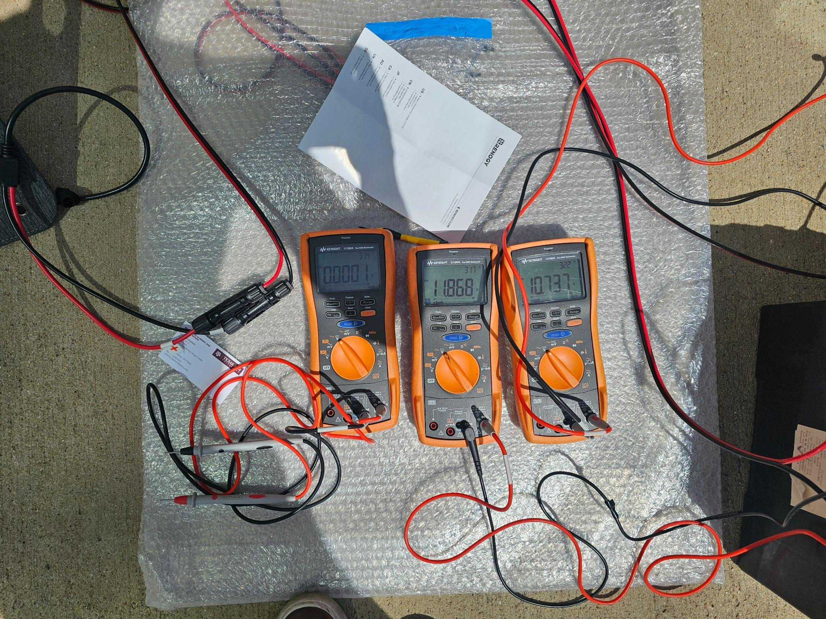
MPPT Charge Controller Adam Garcia

Slide 7
Physical Controls Jack Holdridge
Accomplishments Update 18 Hours | Ongoing progress/problems and plans until the next presentation
Verified stable system power distribution to MCU, relays, sensors, and security camera during integrated system operation Verified battery-powered system operation, maintaining full functionality of lighting, sensing, and communications when solar input is removed Integrated and verified motion sensors and security camera hardware connections, confirming proper power delivery and detection functionality Confirmed local hardware response path: MCU commands correctly actuate lighting and physical system components | Validate stable power rail operation under sustained system load during extended integrated runtime Validate long-duration system operation to ensure overall power subsystem stability Integrate charge controller telemetry with MCU monitoring for battery and system power status reporting

Slide 8
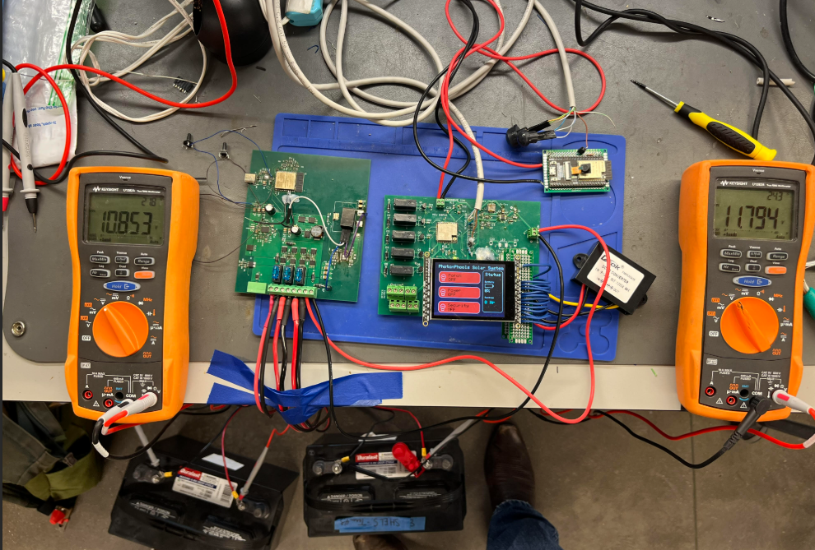
Physical Controls Jack Holdridge

Slide 9
Android Application and Camera Kyle Walcher
Accomplishments since last update 12 hrs of effort | Ongoing progress/problems and plans until the next presentation
Validated Motion Sensor to Camera Efficiency Validated Battery Percentage to Application Reliability | Developing enhancements to application to reduce time and improve efficiency Validating lighting control time and reliability test

Slide 10
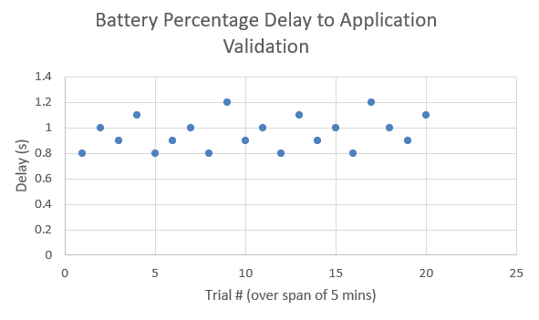
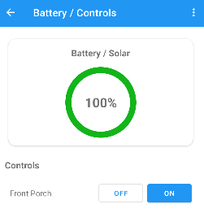
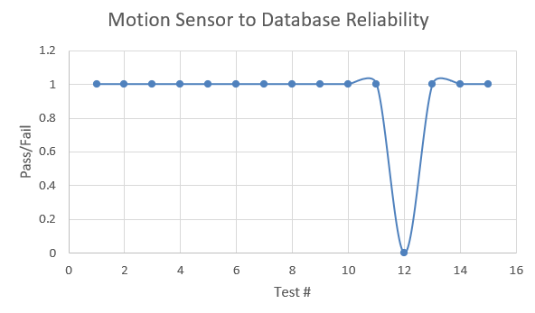
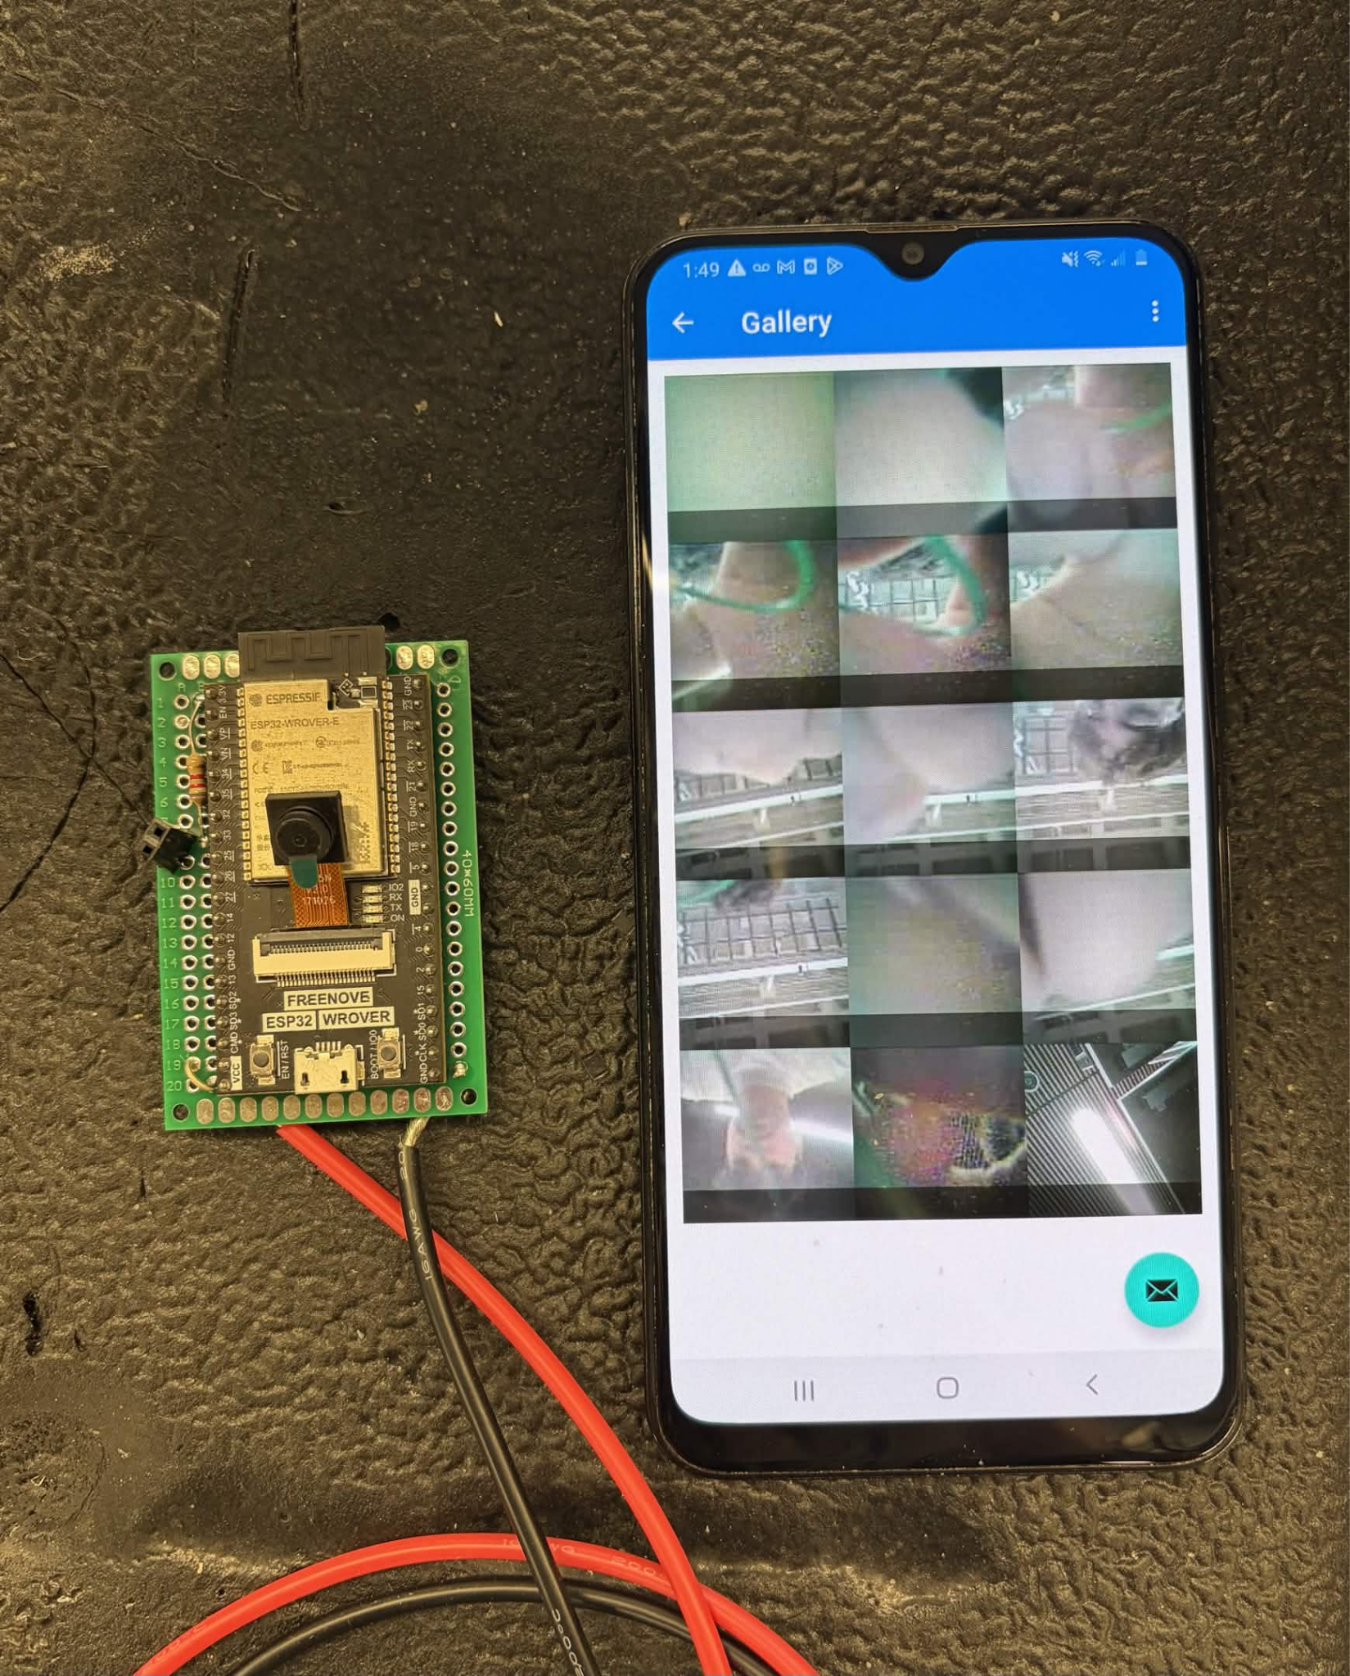
Android Application and Camera Kyle Walcher
Battery % Test
- Uses Firestore Listener to update from database
- Avg. of 0.96s over 5 minutes
-100% Success Rate; no update uncounted
-MUST have stable connection to WiFi
Camera/Motion
- Camera Connects to Jacks PCB with sensor
- 14/15 Successful attempts, 1 false positive
- Investigating sensor sensitivity

Slide 11
MCU, Sensors & Database Matthew Greer
Accomplishments Update 12 Hours | Ongoing progress/problems and plans until the next presentation
Validated local control loop: Touchscreen → MCU → Lighting Verified sensor detection and processing: PIR and LDR inputs correctly interpreted by MCU Established and tested MCU → Database communication pipeline for system state updates Verified RTOS task separation (Control, UI, Network) maintains responsive system operation | Validate end-to-end remote control: App → Database → MCU → Lighting response Integrate and validate charge controller telemetry → MCU → Database pipeline Execute full nighttime scenario validation (low light + motion → lighting + database update)

Slide 12
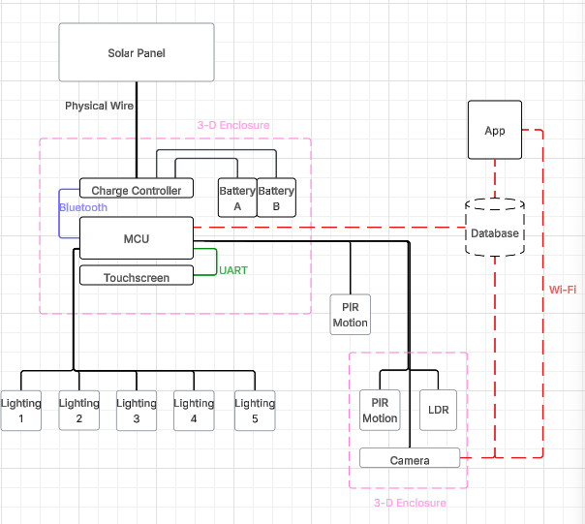


MCU, Sensors & Database

Slide 13
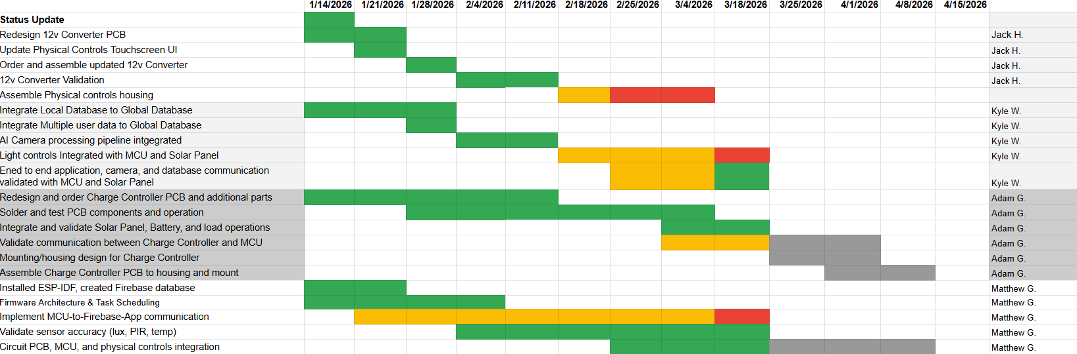
Execution Plan
Notes:
Michelle

Slide 14
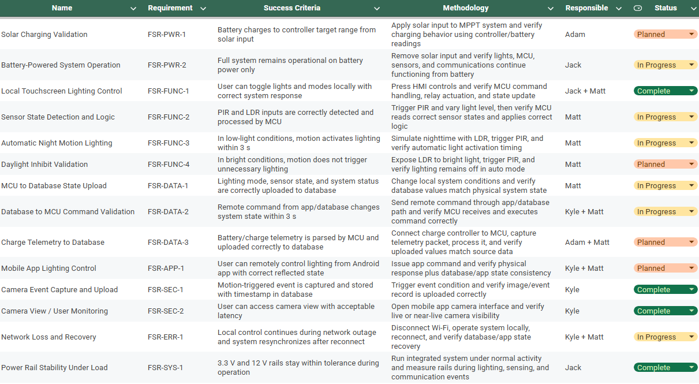
System Validation Plan

Slide 15
Solar Home Lighting 3:
Thank you for listening!
Questions?
Jack Holdridge
Kyle Walcher
Matthew Greer
Adam Garcia
TA: Guanhua Tao
Sponsor: Won Jang

